Slide 1
Services
Lecture 8
Tom Karni, Itsik Avidan

Slide 2
Intro
Designed to run in the background
Update Content Providers
Fire intents
Trigger notifications
Handle events
Perfect means of performing ongoing or regular processing
Network transactions
Play music
File I/O

Slide 3
Intro
Can be created from any component (Activity, another Service , BroadcastReceiver ) in any application
Forms :
Started – run in the background indefinitely without dependency in its creator
Bound – allows “client-server” terminology, runs as long as another component is bound to it
Runs on the UI thread

Slide 4
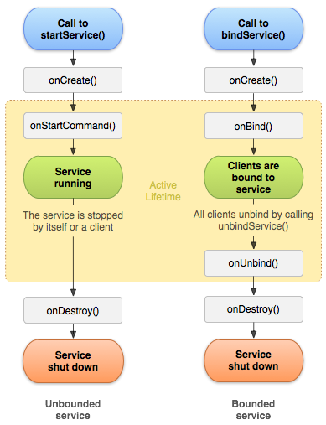
Creation
Extend the Service.class
Implement abstract methods
onCreate()
onStartCommand() : int
onBind() : IBinder
onDestroy()

Slide 5
Started Service
In-order to start a service call startService() and pass the Intent that specifies the Service
In-order to stop the service
Within the Service - stopSelf()
From another component - stopService()
It's important that your application stops its services when it's done working, to avoid wasting system resources and consuming battery power

Slide 6
IntentService
The basic assumption – most of the Services don’t need to handle multiple request simultaneously
IntentService :
Creates a worker thread that contain the Service
Created a queue for accessing the Service
Stops the Service in time

Slide 7
IntentService - Create
Extend the IntentService.class
Constructor which call its super
Implement the abstract method
onHandleIntent()
Have the option to override the other Service abstract methods, just call the super

Slide 8
BoundedService
When you want to interact with the service from activities and other components
Allows application components to bind to it by calling bindService() in order to create a long-standing connection
Must implement the onBind() : IBinder which defines the communication interface

Slide 9
BoundedService
3 ways to provide the IBinder interface to communicate with the Service
Extend the Binder.class - for private Services which runs on the same process as its client
Using the Messenger - interface to work across different processes
Using AIDL - decompose objects into primitives that the operating system can understand and marshal them across processes to perform IPC

Slide 10
Binder
Extend the Binder.class
Build the class that either :
Contains public methods
Return the Service instance which has public methods
In the Service Implement onBind() : IBinder and return the Binder
In the client receive the Binder from the onServiceConnected() under the ServiceConnection

Slide 11
Messenger
Communicate with remote process
Defines an interface for you Service for other Applications and allows IPC
An implementation of AIDL

Slide 12
AIDL
Android Interface Definition Language allows to define an interface between two process in a Server-Client terminology
In-order both applications will know the interface – create *.aidl file under <project>/src/ directory in both projects
Extend the auto generated Stub subclass and implement its methods
Implement a Service and override onBind() to return your implementation of the Stub

Slide 13
References
Android developers [http://developer.android.com]
W.Frank Ableson, Robi Sen, Chris King. “Android in Action, 2nd edition”, 2011.
Reto Meier. “Android – Application Development, 2nd edition” , 2011

